Slide 1
Java 4 WEB
Lesson 12 – Servlet API

Slide 2
Lesson goals
Client-Server
Static vs dynamic content
Java Servlet
Tomcat

Slide 3
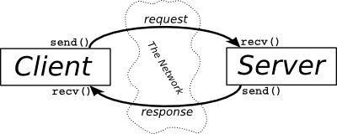
Client-Server architecture
A person enters a URL string into the browser.
The browser generates HTTP-request.
The server receives a request, processes, and sends an HTTP response.
The browser receives a response and displays it.
Notes:
Scenario of the WWW network use by person

Slide 4
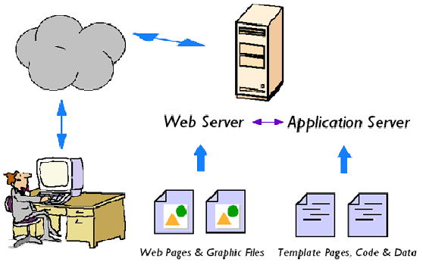
Client-Server architecture
• Web-server for static content (popular): Apache, nginx, GWS, IIS, ...
• Software for dynamic content: CGI programs & modules, PHP AS,
MS IIS AS, Java EE, ...

Slide 5
CGI - Common Gateway Interface
Standard used to communicate of the web server with an external program for generating dynamic web content.
CGI-script - a program that works on the CGI-interface. Web-server is configured to redirect certain URL requests for CGI scripts.
Notes:
Any language can be used to create CGI scripts, It supports the work with standard I/O devices (even sh-scripts).

Slide 6
CGI - Common Gateway Interface
Shortcomings of CGI technology:
● Start an OS process for each request
● A lot of low-level coding
● No sharing resources across requests
● No session state

Slide 7
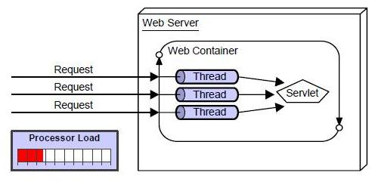
Http Servlet
service(HttpServletRequest, HttpServletResponse)
doGet(HttpServletRequest, HttpServletResponse)
doPost(HttpServletRequest, HttpServletResponse)
Notes:
One of the replacements was the web container and Java servlets.

Slide 8
Java Servlet
@WebServlet(name = "helloServlet", urlPatterns = {"/hello"}) public class HelloServlet extends HttpServlet { public void doGet( HttpServletRequest request, HttpServletResponse response ) throws IOException { response.setContentType("text/html"); PrintWriter out = response.getWriter(); out.println("<h1>Hello World</h1>"); } }

Slide 9
Java Servlet 4.0
HTTP /2
Request/Response multiplexing
Stream Prioritization
Server Push
Upgrade from HTTP 1.1

Slide 10
Servlet Lifecycle
Loads the servlet class
Creates an instance of the servlet class
Initializes the servlet instance by calling the init() method
Does all work
When the container needs to remove the servlet, it calls the servlet’s destroy() method

Slide 11
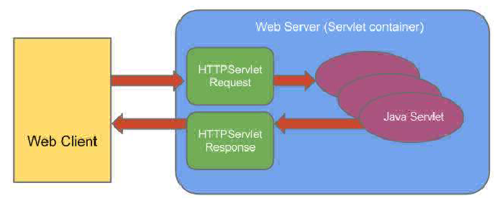
HttpServletRequest
Container creates HttpServletRequest object and passes it as argument to Servlet's service methods (doGet, doPost, etc.)
HttpServletRequest provides client request info to Servlet.
Passed to the service(...) method, doGet (...), doPost (...), do ... ().

Slide 12
HttpServletRequest
Methods:
- getHeader (String)
- getParameter (String)
- getInputStream ()
- getSession ()
- getServletContext ()
- etc

Slide 13
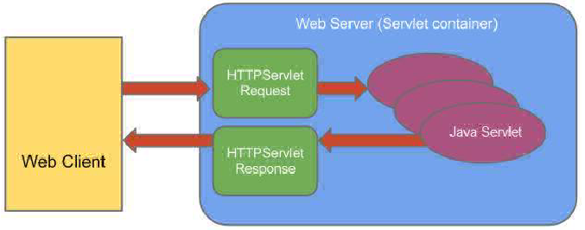
HttpServletResponse
Container creates HttpServletResponse object and passes it to Servlet's service methods (doGet, doPost, etc.)
HttpServletResponse assists a servlet in sending a response to the client.
As well as HttpServletRequest is passed in service(...) and do...(...)

Slide 14
HttpServletResponse
Methods:
- addHeader (String, String)
- setStatus (int)
- sendError (int)
- sendRedirect (String)
- setHeader (String, String)
- getWriter ()
- etc

Slide 15
HttpSession
HttpSession session = request.getSession();
Main methods:
- invalidate ()
- getAttributeNames ()
- getAttribute (String)
- removeAttribute (String)
- setAttribute (String, Object)
- etc
Notes:
HttpSession provides a way to identify a user across several requests or visits to Web site and to store information about that user.

Slide 16
ServletContext
Servlet uses ServletContext to communicate with its servlet container, access the servlet container.
ServletContext sc = request.getServletContext();
Main methods:
- getAttributeNames ()
- getAttribute (String)
- removeAttribute (String)
- setAttribute (String, Object)
- etc
Notes:
An object of ServletContext is created by the web container at time of deploying the project. This object can be used to get configuration information from web.xml file. There is only one ServletContext object per web application.

Slide 17
Filter
@WebFilter(urlPatterns = {"/*"}) public class HelloFilter implements Filter { public void init(FilterConfig cfg) { } public void doFilter(
ServletRequest req, ServletResponse resp, FilterChain chain ) throws ServletException, IOException { chain.doFilter(req, resp); } public void destroy() { } }
Notes:
A filter is a Java class that can transform the header and (or) content of request or response

Slide 18
Error Handling
@WebServlet("/error") public class ErrorHandler extends HttpServlet { private static final long serialVersionUID = 1L; @Override protected void doGet(HttpServletRequest req, HttpServletResponse resp) throws IOException { resp.setContentType("text/html; charset=utf-8"); try (PrintWriter writer = resp.getWriter()) { writer.write("<html><head><title>Error description</title></head><body>"); writer.write("<h2>Error description</h2>"); writer.write("<ul>"); Arrays.asList( ERROR_STATUS_CODE, ERROR_EXCEPTION_TYPE, ERROR_MESSAGE) .forEach(e -> writer.write("<li>" + e + ":" + req.getAttribute(e) + " </li>") ); writer.write("</ul>"); writer.write("</html></body>"); } } }

Slide 19
Error Handling
<?xml version="1.0" encoding="UTF-8"?> <web-app version="4.0" xmlns="http://xmlns.jcp.org/xml/ns/javaee" xmlns:xsi="http://www.w3.org/2001/XMLSchema-instance" xsi:schemaLocation="http://xmlns.jcp.org/xml/ns/javaee http://xmlns.jcp.org/xml/ns/javaee/web-app_4_0.xsd"> <display-name>Web Project</display-name> <error-page> <exception-type>java.lang.RuntimeException</exception-type> <location>/error</location> </error-page> </web-app>

Slide 20
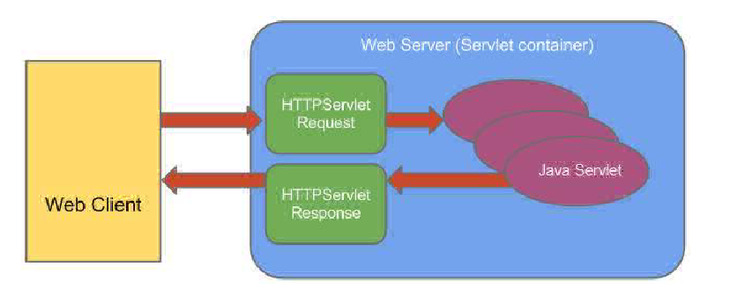
Web (servlet) container
A Web server - component that interacts with Java Servlets.
Primary responsibilities are:
- Management of servlets and their life cycle
- Mapping the URL to a specific servlet.
- Check access rights
Notes:
The basic idea of Servlet container is using Java to dynamically generate the web page on the server side. So servlet container is essentially a part of a web server that interacts with the servlets.

Slide 21



Java EE & Servlet (Web) Container
Most popular Servlet (Web) Containers
• Apache Tomcat
• Jetty
• JBoss Application Server (WildFly)
• …

Slide 22

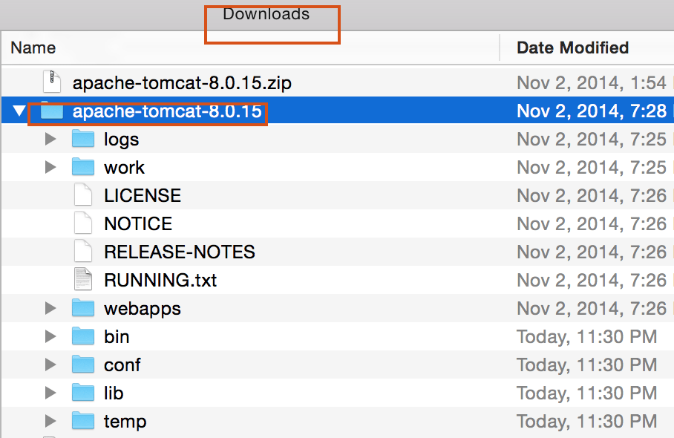
Apache Tomcat

Slide 23
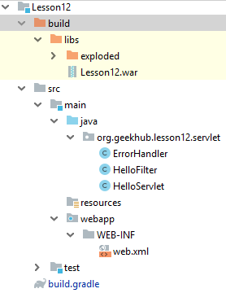
WAR
Web application ARchive - is a JAR file used to distribute a collection of JavaServer Pages, Java Servlets, Java classes, XML files, libraries, static web pages (HTML, JS, CSS, etc) and other resources…

Slide 24
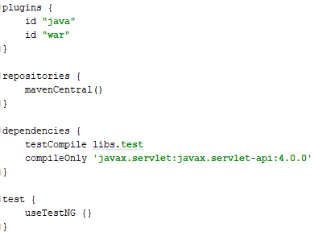
WAR

Slide 25
Literature
Building Java Web Applications
Servlets (by Baeldung)
Servlets (by Tutorialspoint)
How to Install Apache Tomcat
What is servlet container
Servlets (by Jetbrains)

Slide 26
Homework Task 1
Implement a servlet with interface:
`/session?action=[add/update/remove/invalidate]&name=...&value=...`
1. The servlet generates a form with input fields "action", "name", "value" and button "Submit". Below print is a list of all attributes of the user session.
action - depending on the value, the servlet adds, updates, or removes an attribute in/from a session;
name - the name of the attribute;
value - is the value of the attribute.
2. If any error happens – log and redirect user to custom error page
3. Add request blocking filter, when user browser is ‘Microsoft Edge’ – block request and show error page. Use
4. Add separate request logging filter. Log endpoints path and total execution time. Should measure all actions (even when request blocked)
5. Add separate request blocking filter. When today is weekend – deny all operations. Microsoft Edge users should never come here and be stopped by user-agent filter.
6. Attributes lists should not be shared between two browsers

Slide 27
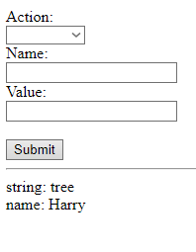
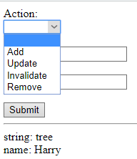
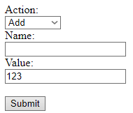

Homework Task 1

